Slide 1
Bot Framework Overview

Slide 2




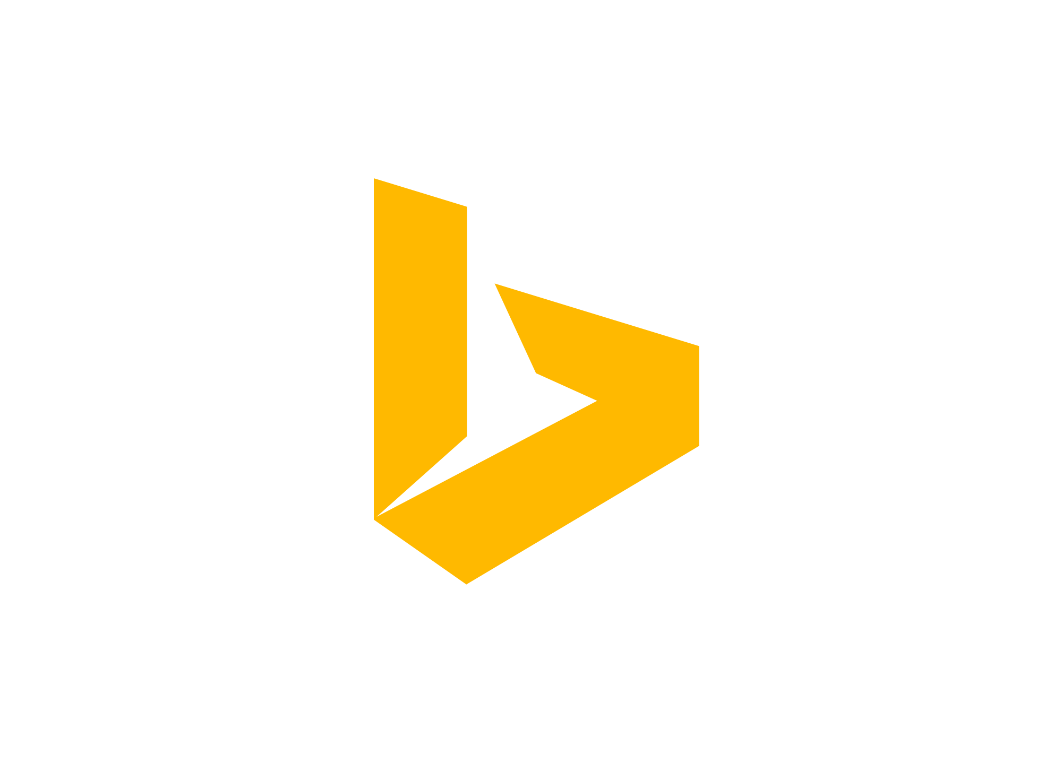
Why a Bot?
TYPE
TALK
TAP
Bot Builder
Cortana
Facebook Messenger
Skype
Platform Services
Intelligent Tools
Bing

Slide 3

What is a Bot?
Platform
Platform Services
HTTP
AI
{ Your Code }
REST Endpoint
SDK
Intelligent Tools
Bot Builder SDK
REST Endpoint
Direct Line Protocol
Conversational and Business Logic
Canvas Aware
Context Sensitive

Slide 4



What is the Bot Framework?
What?
Tools for building REST Web Sites
Services to enrich
Mechanisms for receive events
Data to debug and analyze
Customer’s
Business Logic & Data
Bot Connector
Why?
Implements standard protocols
Modeling conversations is hard. Tools help!
UI across multiple canvases is hard. Cards rock!
Language Understanding is hard
Common and well understood patterns
C#
BOT BUILDER
Bot Controls
Skype
Bing
Web Chat
Goals
Start Simple. Add Complexity. No dead-ends.
Bot adapts to the user, based on context
Composable and intelligent controls to manage complexity
LUIS
Form Filling
QnA
Skype for Business
Cortana
Direct Line
Query over database via Azure Search
3rd Party

Slide 5
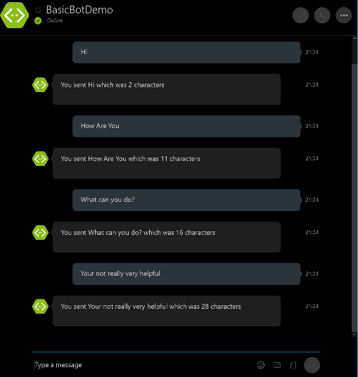
Bots are not intelligent out of the box.

Slide 6
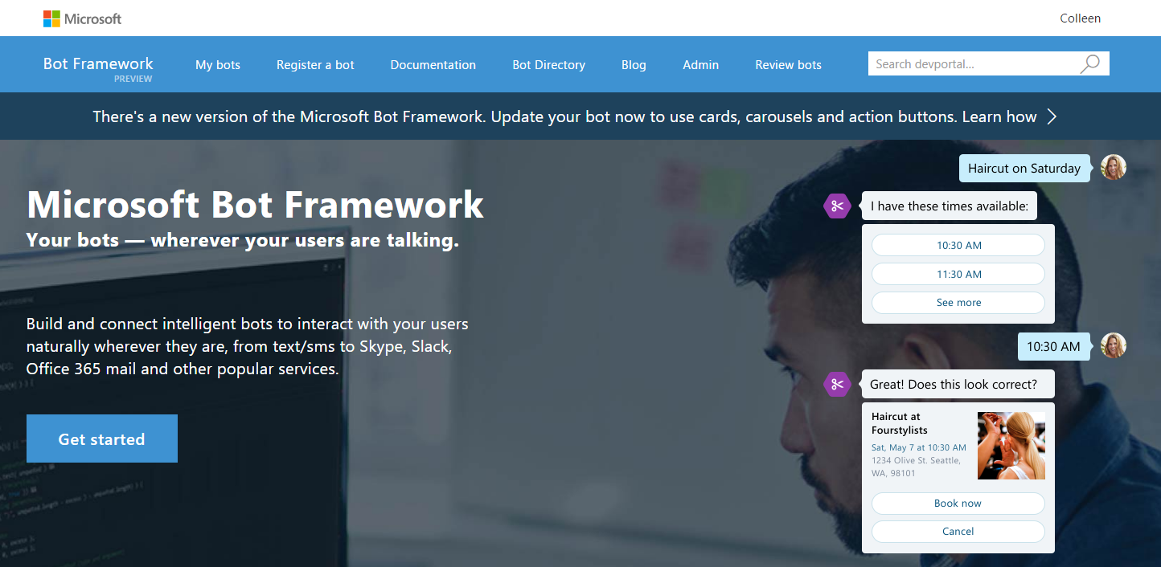

www.botframework.com
Notes:
Animation set to loop
Bot Framework provides everything you need to build and connect intelligent bots that interact naturally wherever your users are talking, from text/sms to Skype, Slack, Office 365 mail and other popular services.
Bot Framework consists of three main components: Bot Builder SDKs, Developer Portal, and Bot Directory

Slide 7





Your Bot Framework
Bot Builder
Developer Portal
Bot Directory
Tools and services to build great bots that converse wherever your users are.
Connect your bots to text/sms, Skype, Slack, Facebook Messenger, Office 365 mail and other channels.
Try, use, and add published bots to the world’s top conversation experiences.
Open source SDK on Github for Node.js, .NET and REST
From simple built-in prompts and command dialogs to simple to use yet sophisticated ‘FormFlow’ dialogs
Support for rich attachments (image, card, video, doc, etc.); support for calling (Skype)
Online/offline chat Emulator
Add bot smarts with Cognitive Services for language understanding and more
Register, connect, publish and manage your bot through your bot’s dashboard
Automatic card normalization across channels
Skype channel auto-configured
Embeddable Web chat control
Host your bot in your app via the Direct Line API
Fast, scalable message routing
Diagnostic tools
Public directory of bots registered and published with Microsoft Bot Framework
Users can try your bot from the directory via the Web chat control
Users can discover and add your bot to the channels on which it is configured when the Directory is made public to end users

Slide 8
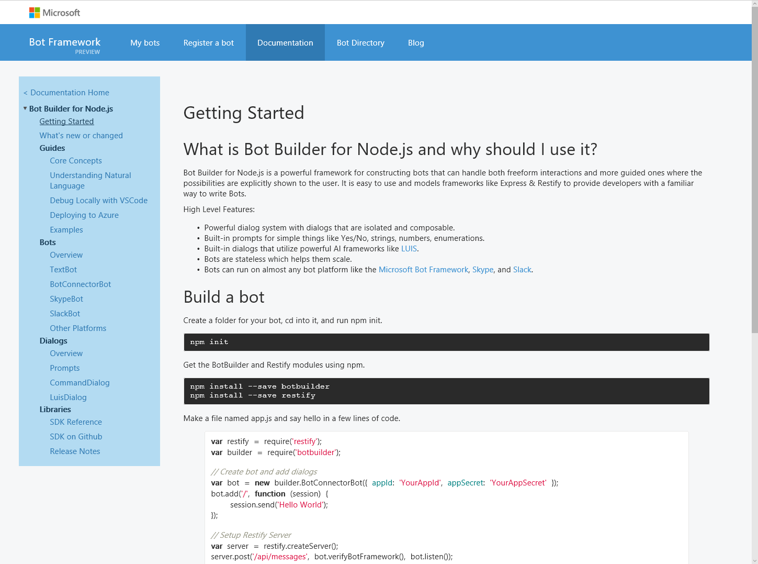
Bot Builder SDK
Node.js, .NET and REST
Dialogs to model conversation
Dialogs are reusable
Types of Dialogs include:
Built-in prompts
Yes/No, String, Number, Choices
FormFlow and form slot filling (branching, disambiguation, multi-turn)
Conversations are scalable to multiple machines
Rich interactions
Support for rich attachments (image, card, video, doc, etc.); support for calling (Skype)
Service extensions for language understanding (LUIS) and translation
Online/offline Chat Emulator
Samples

Slide 9
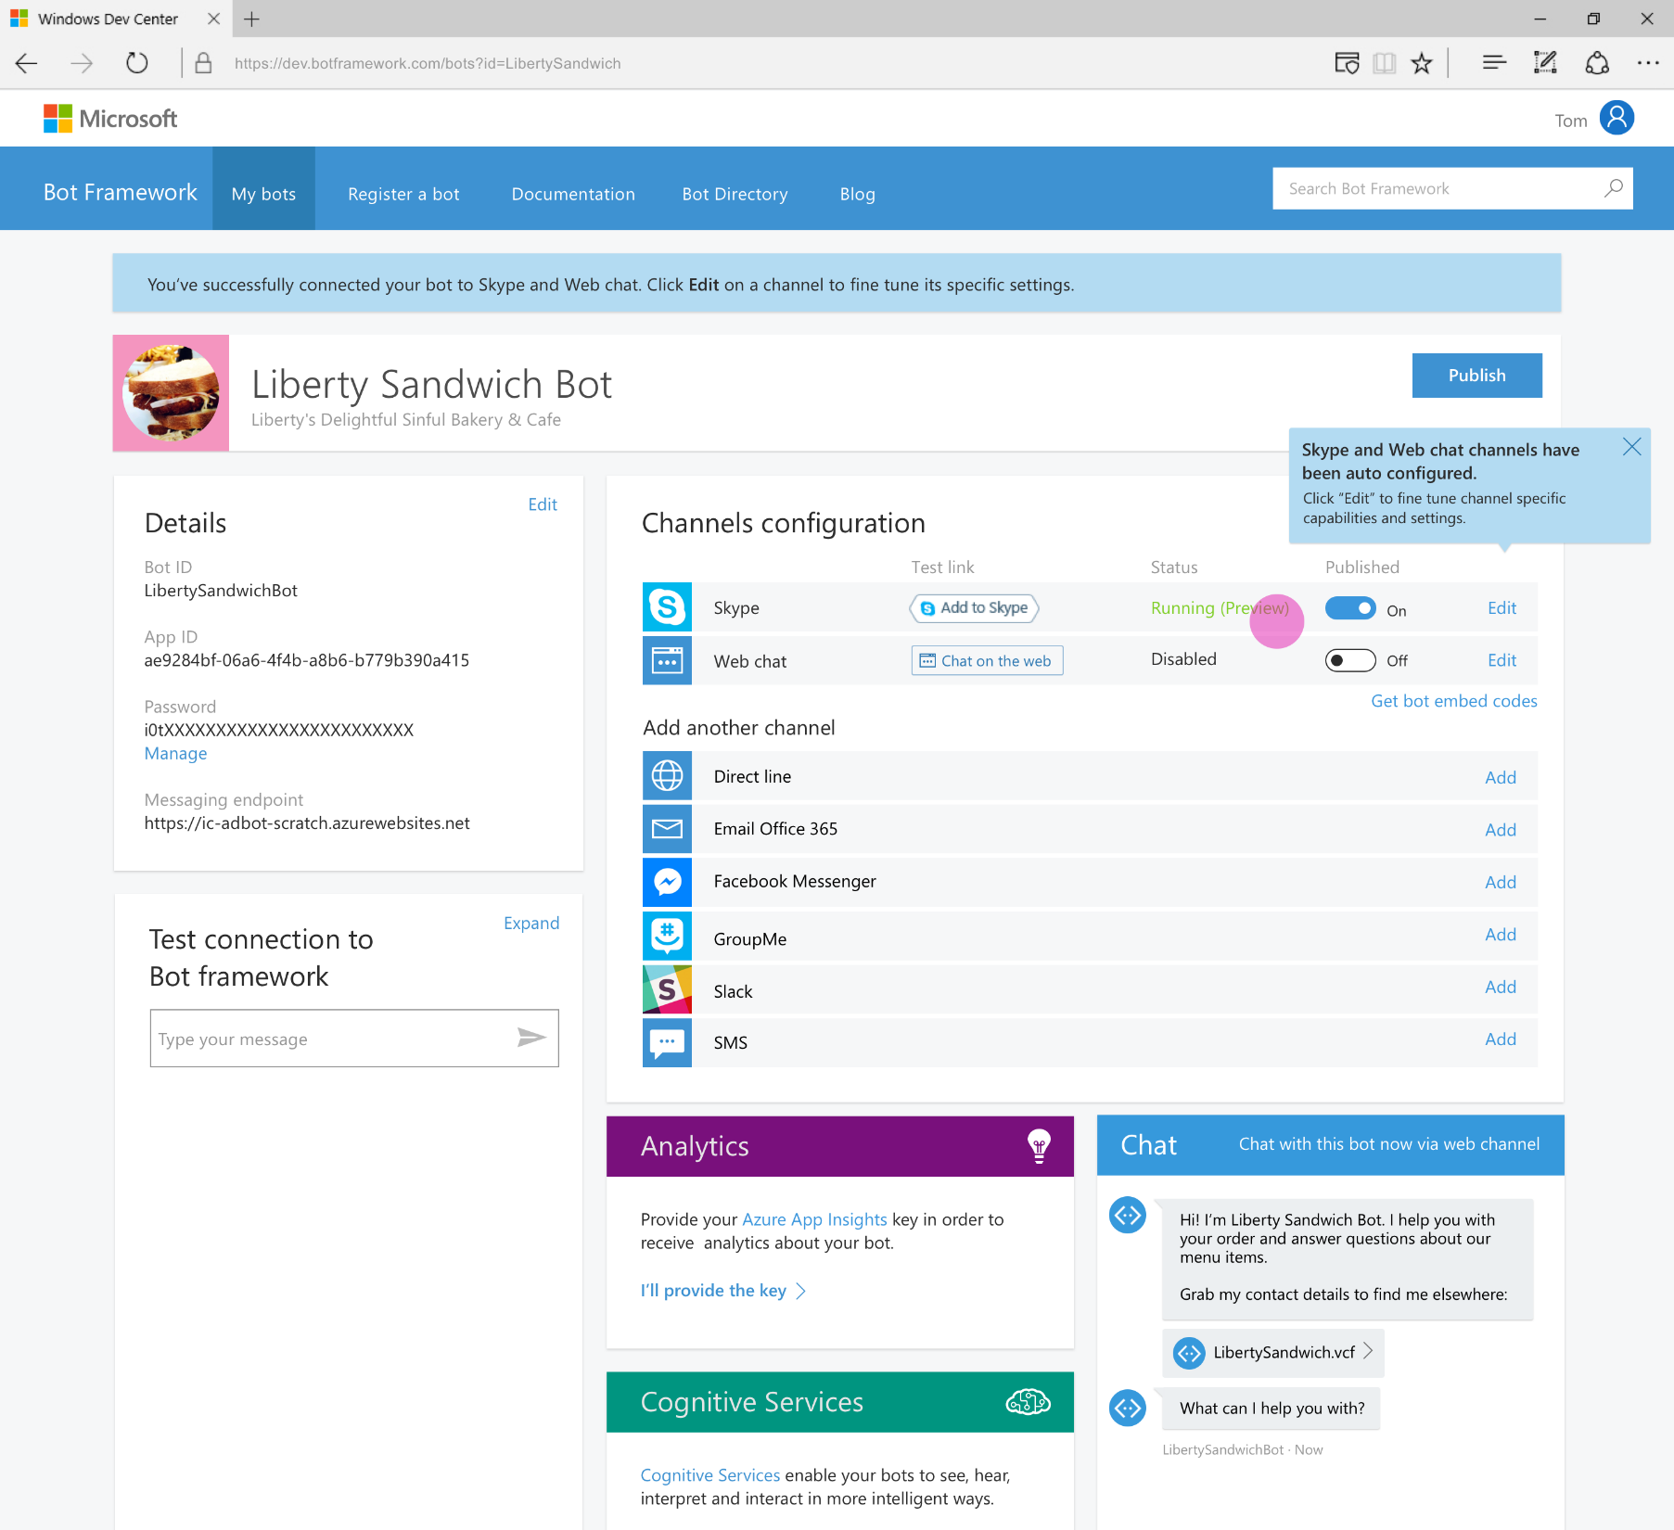
Developer Portal
Register your bot
Connect to channels
Test
Publish
Manage
Measure

Slide 10
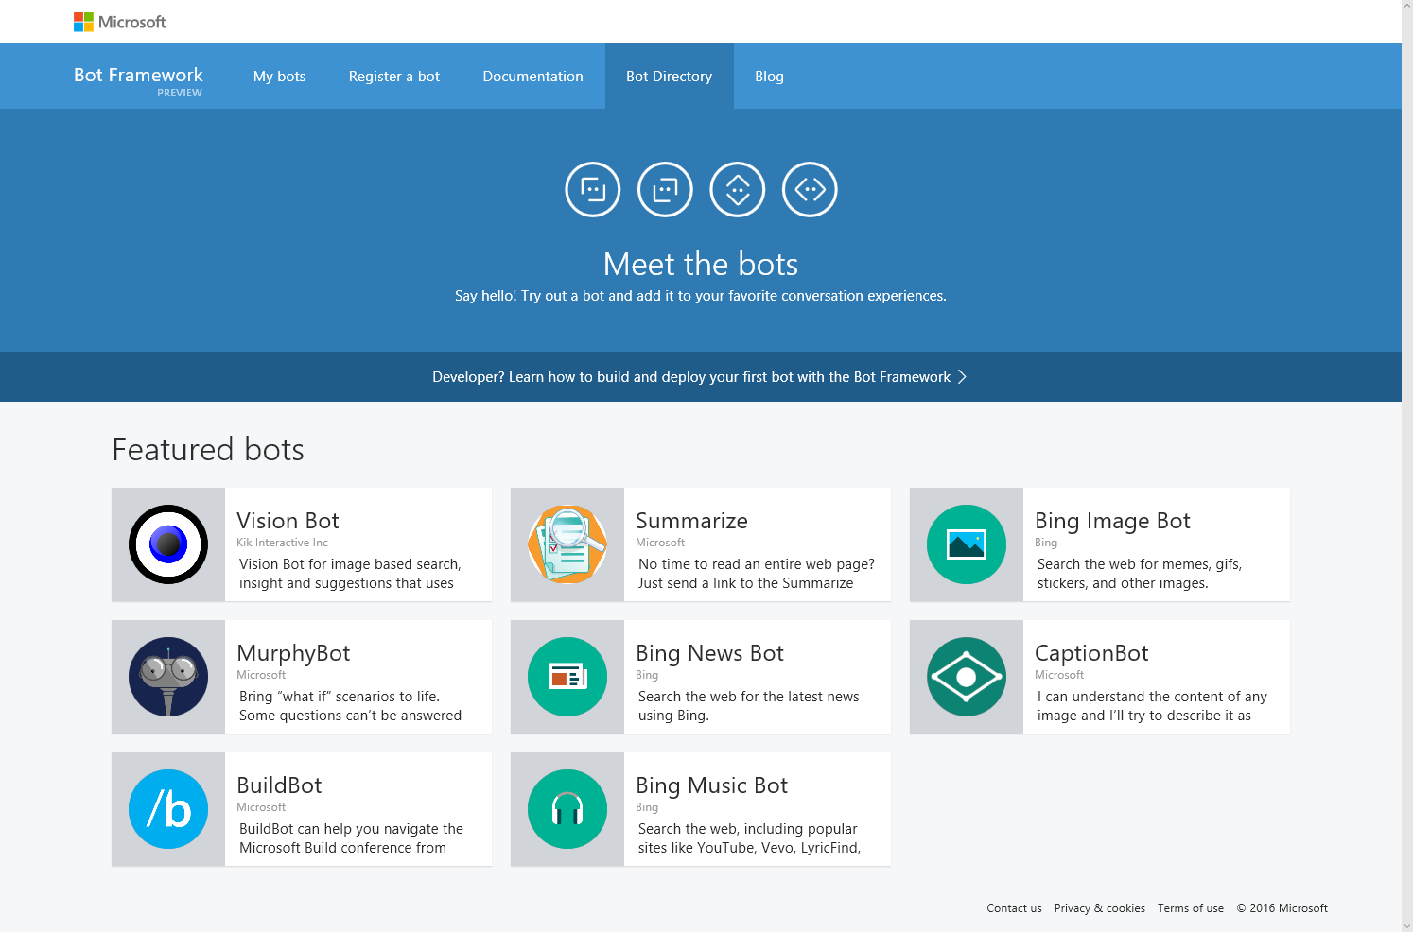
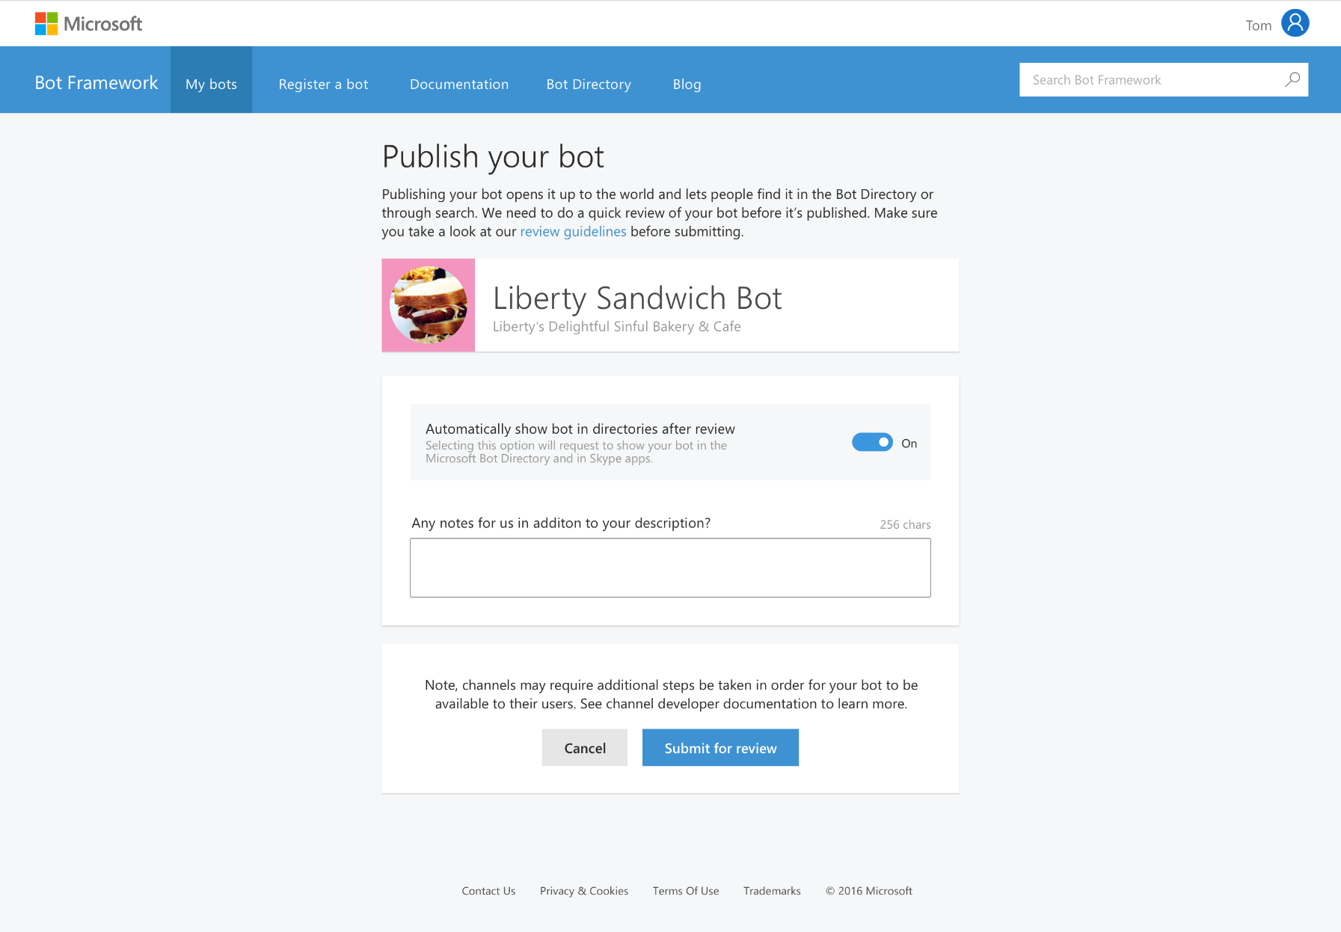
Bot Directory
Public Directory of Bot Framework Bots
Users can discover, try, and add bots to the conversation experiences on which the bot is configured (no app required)
Bots are public at developer discretion; bots must be submitted for review in order to appear in the directory
Searchable

Slide 11
Greater than the sum of its parts Bots + Cognitive Services
Maps
Computer
Vision
Spelling
Custom
Vision
Bing
Entity
Text
Analytics
LUIS
Translator

Slide 12
Common Business Scenarios
Customer Support
Helping users find information and complete simple tasks without the need of human assistance.
Retail
Provide seamless customer support throughout the shopping experience
Insurance
Improve customer acquisition
Automotive
Employee Productivity
Provide knowledge to general questions
Information on vehicles, inventory levels, incentive plans, user manuals and answer general knowledge questions.
Increase employee engagement, simplify common internal tasks and provide immediate answers to general knowledge questions

Slide 13
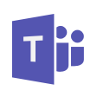










New Channels
One Bot
Multiple canvases

Slide 14



New Channels
One Bot
Multiple canvases
Custom Skills
Business Bots
LOB Bots
Memory / Profile
Bot Directory
IT Managed
Speech
Bots in Bing Search
Integrated Auth

Slide 15

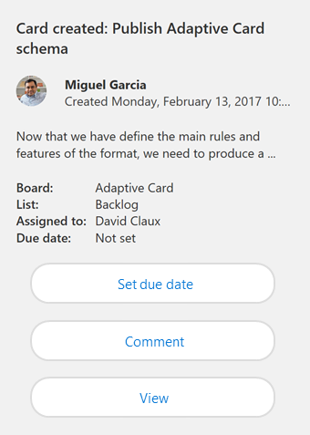
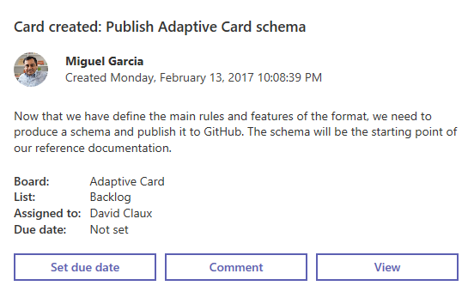
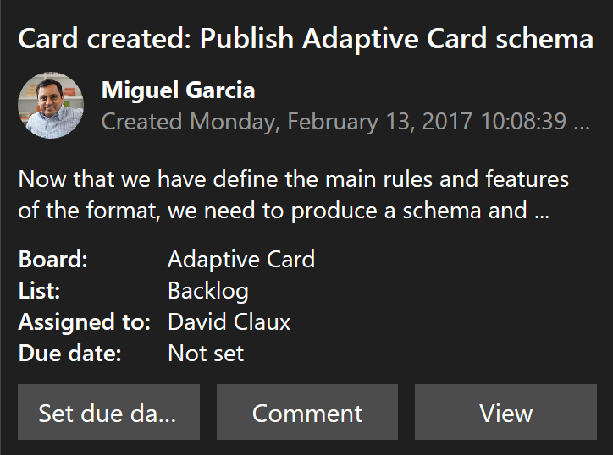
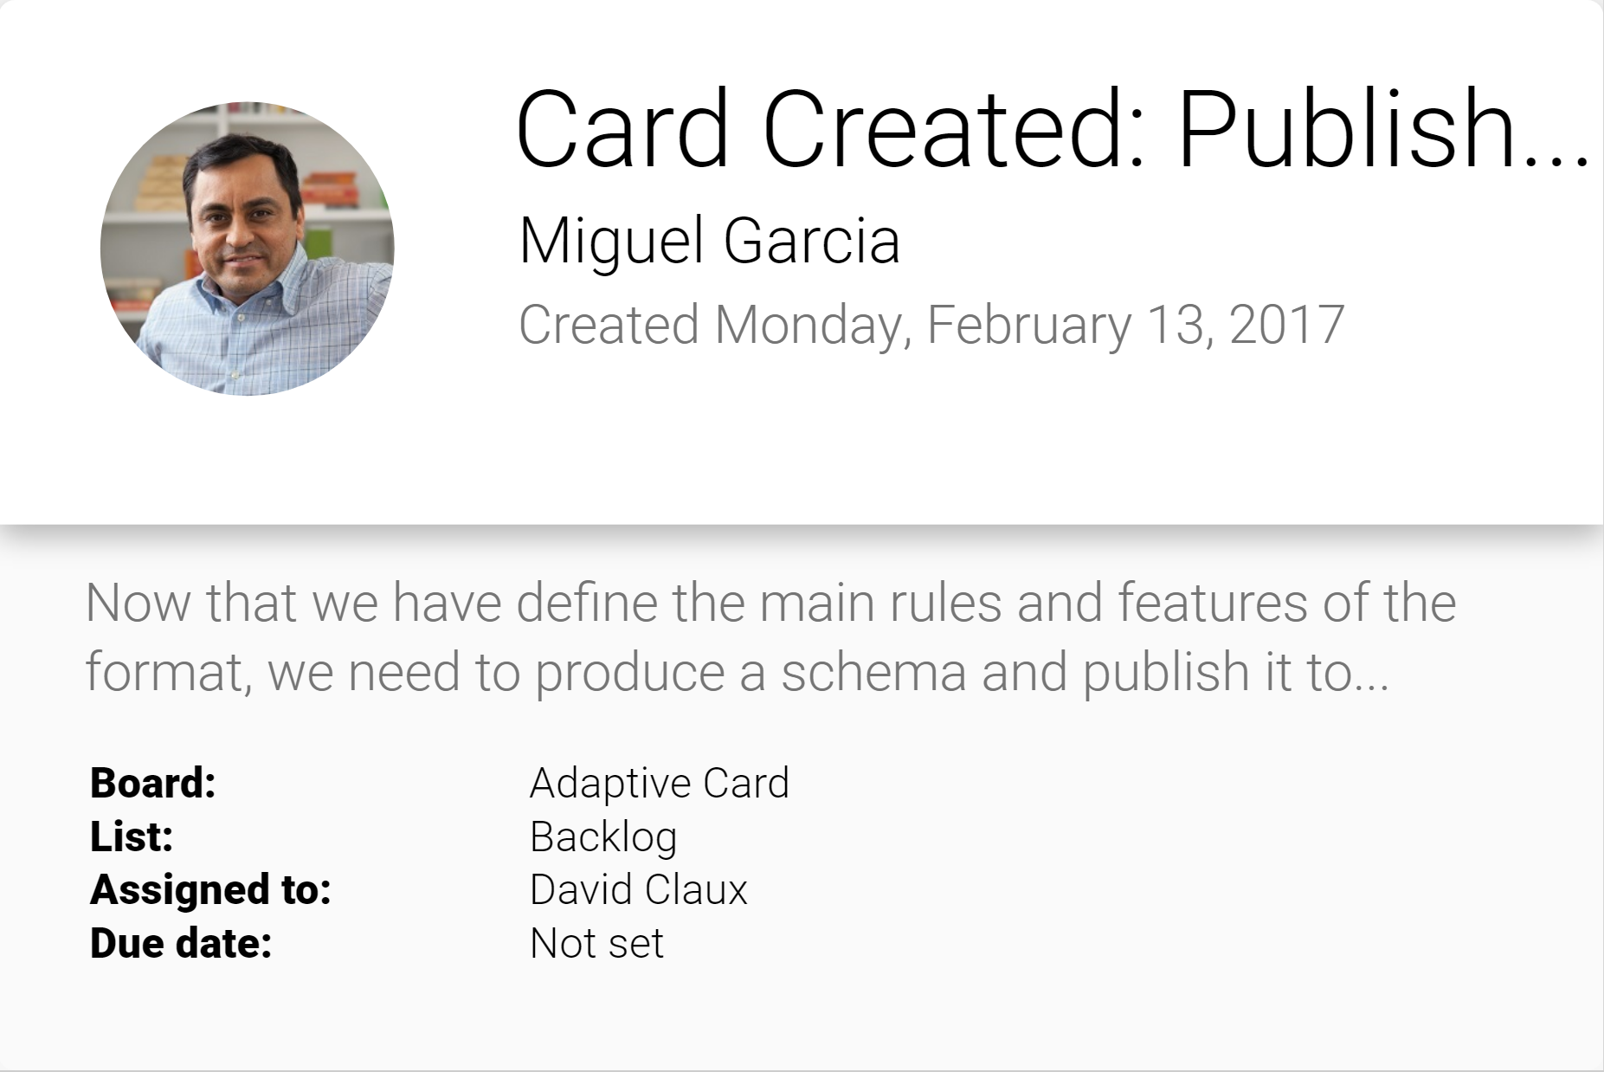
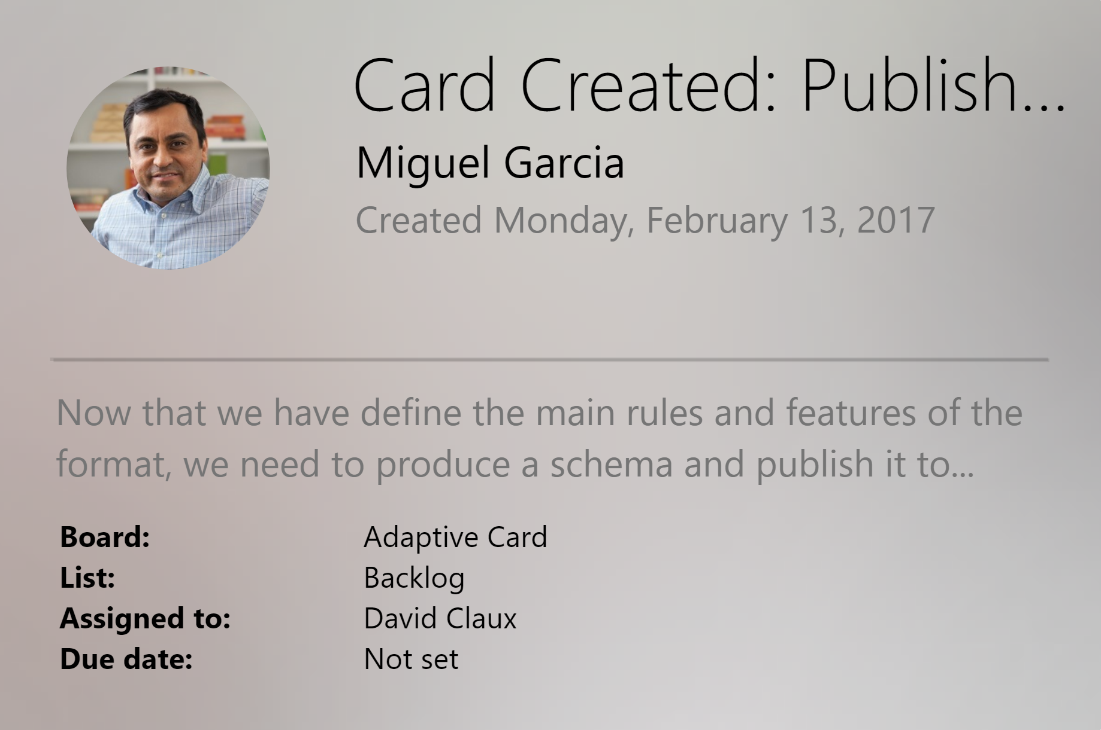
Adaptive Cards
Open framework
Multiple canvases
Notification
Microsoft Teams
Skype
Android
iOS

Slide 16
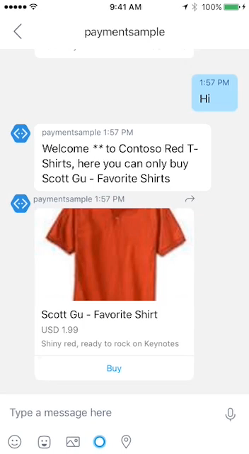
Payments
Stripe is currently supported
Visit Microsoft Seller Center
Obtain MerchantID
Start building
Works across most major platforms
Fast and simple payment experience
Bring commerce capabilities to your Bot
Learn More on Microsoft Seller Center!
Read the integration guide for the Bot Framework.

Slide 17
Speech
Deep Integration
Across the Bot Framework
SPEECH IN PROTOCOLS
SPEECH IN SDKS
SPEECH IN LUIS
DirectLine Support
SSML
Modeled Conversations
WebChat Control
Speech Friendly Prompts
Common Model (Cortana, Bing Speech, Custom Speech Recognition)
Cortana
Conversation Management

Slide 18




Bot Architecture
Knowledge and API/Data Integration
Bot Connector
Bot Framework
Message Received
DocDB Product Catalogue
Web Job
Catalogue Files
Chat Language Model
Business Language
Website Links
Stock check API
Intent 1
Intent 2
Live Agents
Unknown Intent
Message Response
Dashboard
Application Insights Telemetry collects bot effectiveness data
Case Workers

